Slide 1
Dictionary in Python

Slide 2
Dictionary
A dictionary is similar to lists and tuples.
It’s another type of container for a group of data.
However, whereas tuples and lists are indexed by their numeric order, dictionaries are indexed by namesthat you choose.
These names can be letters, numbers strings, or symbols

Slide 3
Making a Dictionary
Dictionaries are created using the curly braces.
To start with, you can create the simplest dictionary, which is an empty dictionary, and populate it using names and values that you specify one per line

Slide 4
Dictionary
>>> menus_specials = {}
>>> menus_specials[“breakfast”] = “canadian ham”
>>> menus_specials[“lunch”] = “tuna surprise”
>>> menus_specials[“dinner”] = “Cheeseburger Deluxe”
Dictionary

Slide 5
Dictionaries
there are special names for the indexes and values
Index names in dictionaries are called keys, and the values are called, well, values.
have to specify each key and its corresponding value, separated by a colon, between the curly braces.
>>> menu_specials = {“breakfast” : “sausage and eggs”, ... “lunch” : “split pea soup and garlic bread”, ... “dinner”: “2 hot dogs and onion rings”}
print("%s" % menu_specials["breakfast"])
menu_specials.values()
menu_specials.keys()

Slide 6
Dictionary
A dictionary is a Python object that cross-references keys to values. A keyis an immutable object, such as a string.
A value can be any object.
A dictionary has a canonical string representation: a comma-separated list of key-value pairs, enclosed in curly braces: {key:value, key:value}.

Slide 7
Accessing and updating dictionary mappings
If you try to use a key that doesn’t exist in the dictionary, Python barks out a KeyError exception.
When you don’t want to worry about handling the exception, you can instead use the get (key[, obj]) method, which returns None if the mapping doesn’t exist, and even lets you specify a default value for such cases:

Slide 8
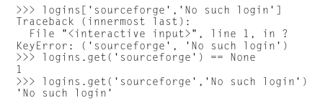

Slide 9
If you just want to know if a dictionary has a particular key-value pair (or if you want to check before requesting it), you can use the has_key(key) method:
>>> logins.has_key(‘yahoo’)
The del statement removes an item from a dictionary:
del logins[‘yahoo’]
logins.has_key(‘yahoo’)

Slide 10
Additional dictionary operations
len(logins) # How many items?
logins.keys()
logins.values()
logins.items()
logins.clear() # Delete everything
logins

Slide 11
The End

